Slide 1
Integrating a SQL Database to the REST API 💾
Implementing ORM in Express app, implementing MVC pattern, using Sequelize (Day 5)
Notes:
Photo by Mark König on Unsplash

Slide 2
Lesson Outcome
By the end of today, you should be able to:
Learn the process of integrating a SQL database into a RESTful API.
Learn how to implement the MVC (Model-View-Controller) pattern and its role in organizing code and reducing complexity.
Learn how to use Sequelize ORM to perform CRUD operations on a SQL database.
Build a Blog Platform REST API with CRUD operations, integrated with a SQL database.

Slide 3
What is ORM?
ORM is an acronym for Object Relational Mapping. ORM act as a bridge between databases and object oriented programming model code. Traditionally, to access data in a database, one needs to write stored procedure or SQL query to do so. With ORM, it eliminates the complexity of writing a query for every task you need to do.
There are ORM libraries that lets you access and manipulate the database by using your desired programming language. There are quite a number of ORMs for NodeJS, but in this course, we are going to use Sequelize.

Slide 4
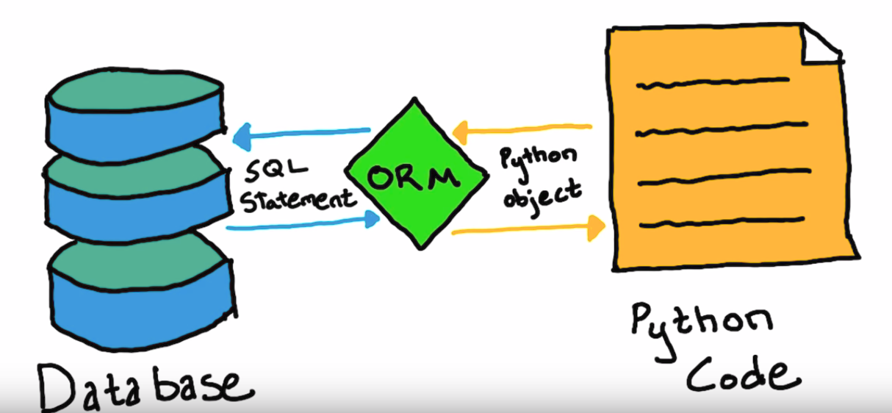

Slide 5
The MVC Pattern in Express.js
Applications can get very complex very quickly. At some point, you will find yourself in a situation where you have to deal with a lot of code. This can make it difficult to understand, maintain, and scale your application.
When it comes to structuring your applications, regardless of the programming language or framework, there are many different ways to do it.
It's important to implement a structure that is easy to understand, maintain, and scale. One of the most popular patterns for structuring applications is the Model-View-Controller (MVC) pattern.

Slide 6
The MVC Pattern in Express.js
In the MVC pattern, the application is divided into three components or layers:
Model: Responsible for managing data layer.
View: Responsible for rendering data and presenting it to the user.
Controller: Responsible for handling user requests, interacting with the Model, and updating the View.
Of course, you can have other components or layers in your application, but MVC pattern provides a good starting point. It helps you organize your code and reduce complexity.

Slide 7
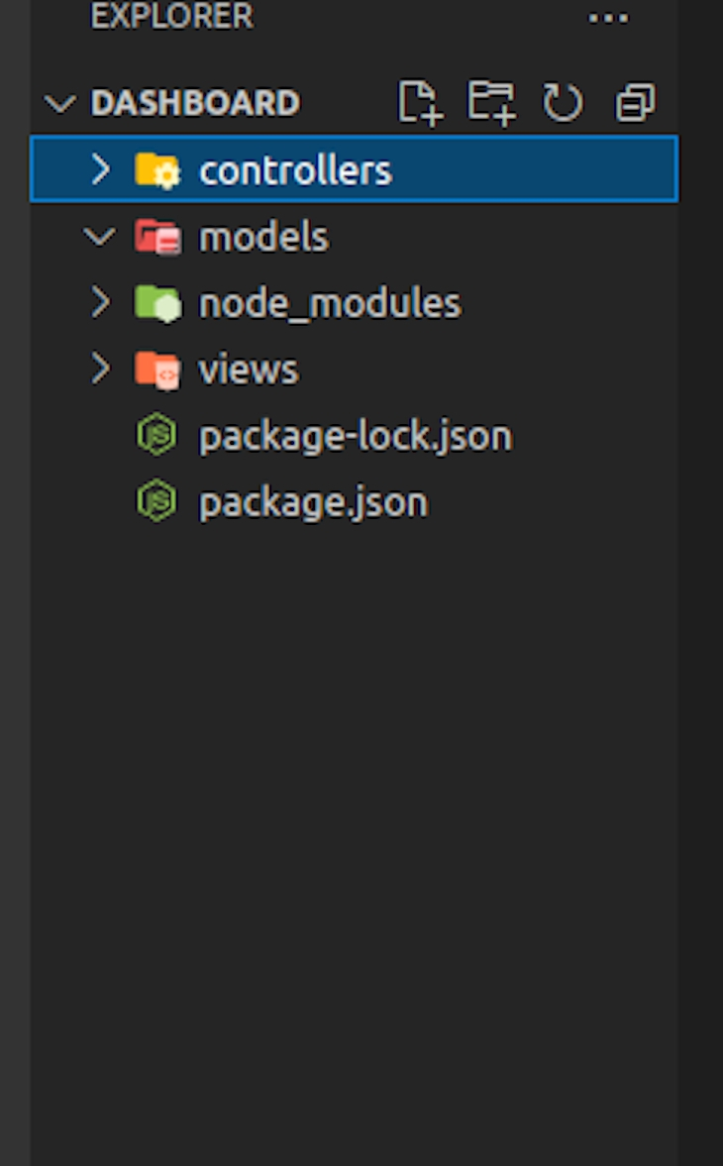
The MVC Pattern in Express.js

Slide 8
Model: Data Logic
Model is responsible for managing data layer.
Represents the data in the application.
Defines the rules that govern access to and updates of this data.
For example, if you are building a blog application, the Model would represent the data in the application such as the blog posts and comments. It would also define the rules that govern access to and updates of this data. For example, it would define the rules for creating, reading, updating, and deleting blog posts and comments.

Slide 9
View: Presentation Layer
Views are the presentation layer of the application. Simply put, they are what the user sees. You don't have to create a views unless you're building a server-side rendered application. In some cases, we might want to keep the frontend and backend separate.
When building an API, the common practice is keeping the frontend and backend separate. Not only it makes the development process easier and faster, but it also eliminates the need to create server-side views.
By separating the frontend and backend, developers can employ different technologies and frameworks, allowing for independent development and enhanced scalability. For example, a popular real-world scenario is building a frontend application using React or Vue that consumes the REST API endpoints provided by the backend, handling the presentation and user interaction on the client-side.

Slide 10
Controller: Application Logic
Controllers as the name suggests, are responsible for controlling the flow of data in the application. They are responsible for handling user requests and interacting with the Model including creating, reading, updating, and deleting data.

Slide 11
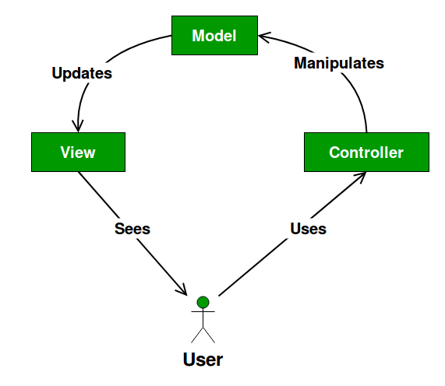
MVC Diagram

Slide 12
Benefits of the MVC Pattern
Other than code organization, the MVC pattern has many other benefits:
Modularity: The MVC pattern promotes modularity. Each layer is responsible for a specific task. This makes it easier to maintain and scale the application.
Reusability: The MVC pattern promotes reusability. For example, you can reuse the same Model in different applications.
Separation of Concerns: The MVC pattern promotes separation of concerns. This makes it easier to maintain and scale the application.
Parallel Development: The MVC pattern promotes parallel development. Each layer can be developed independently. Eg. You can have one person working on the Model and another working on the controller.

Slide 13
Practice Project: Blog Platform API
Now that we've learned the basics of Sequelize and MVC pattern, let's put our knowledge into practice by building an Blog Platform API.
Code Along: Blog Platform API

Slide 14
Self Cover: Express JS: MVC Pattern (all)

Slide 15
Task of the day Task of the Day: Present an Insomnia Demo of the Practice Project.

Slide 16
Take home tasks

Slide 17
Some homework 📚
Self cover: Data Validation
Up until the Capstone Project
Module Capstone Project ~ Create BookingApp
Use the Model-View-Controller (MVC) pattern when creating the BookingApp project.

Slide 18
References
MVC Pattern
Sequelize Data Types
Sequelize Raw Queries
Sequelize Validations

